Slide 1
Event Driven Architecture
Vaccine Transportation Use Case
Jerome Boyer
DE – Event Driven Solution CTO
Cloud Garage Solution Engineering

Slide 2
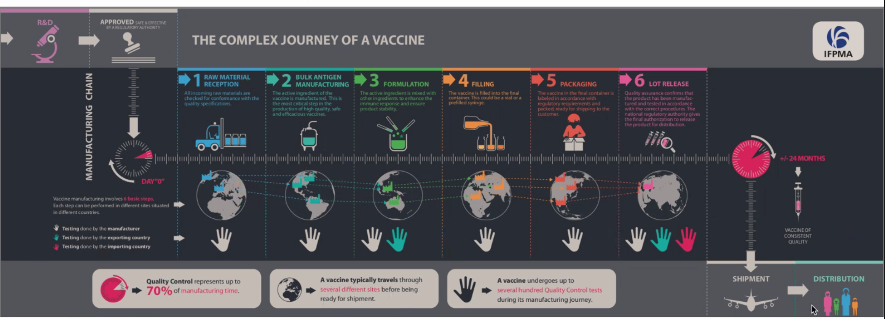
A modern way to manage the vaccine shipment process

Slide 3




Delivering Vaccines at Scale Solution
LifeScience
Vaccine Partner
Government
Provider
Vaccine Distributor
Shipment Container
Omni Channel
Ecosystem & Partners
Hotspot
Detection
Faulty Container
Monitoring
Vaccine
Distribution Optimization
Vaccine
Program Success
Order Management
Crime
Prevention
Intelligent
Workflows
Cognitive Solutions
with trust
Blockchain
API l Business Microservices l Open Ecosystem | Events Processing |
Security and Compliance Framework
IBM Cloud Paks
Application l Integration l Automation l Security l Data l MCM
Operating environment
Open Hybrid Multicloud
Edge
Private Cloud
Core Systems
Z Power

Slide 4
2021 scope
Government
Provider
Vaccine Distributor
Shipment Container
Order Management
Vaccine
Distribution Optimization
Cold Chain Monitoring
Refrigerator Container Management
Faulty Container
Monitoring
Refrigerator
Maintenance Process
API l Business Microservices l Open Ecosystem | Events Processing | BAW
IBM Cloud Paks
Integration l Automation l Data
Multicloud

Slide 5
Business Requirements
Time to market:
Speed to innovate and shorten time to deploy to production
design thinking, even storming, microservices, small team, devops, ML ops...
Complex end to end solution
business partners involvement, trust in data, single source of truth:
blockchain
IT, Data, AI: hot spot, vaccine lot shipment plan optimization
Business partner data sharing:
Event driven, asynchronous, IoT telemetries, cold chain monitoring
Scale solution worldwide
multi-cloud deployment

Slide 6
High Level Architecture
Freezer IoT
Freezer IoT
Decentralize Identity
Order Mgr
API
Shipment Plan Optimizer
Security
Refrigerator Container Mgr
Cold Chain Monitoring
Blockchain Ledger
Multi-cloud management
Event Backbone
AI Anomaly Detection
Event Injection Layer
Itinerary Mgr
Transportation Tracking
ERP
Legacy Order Mgr

Slide 7
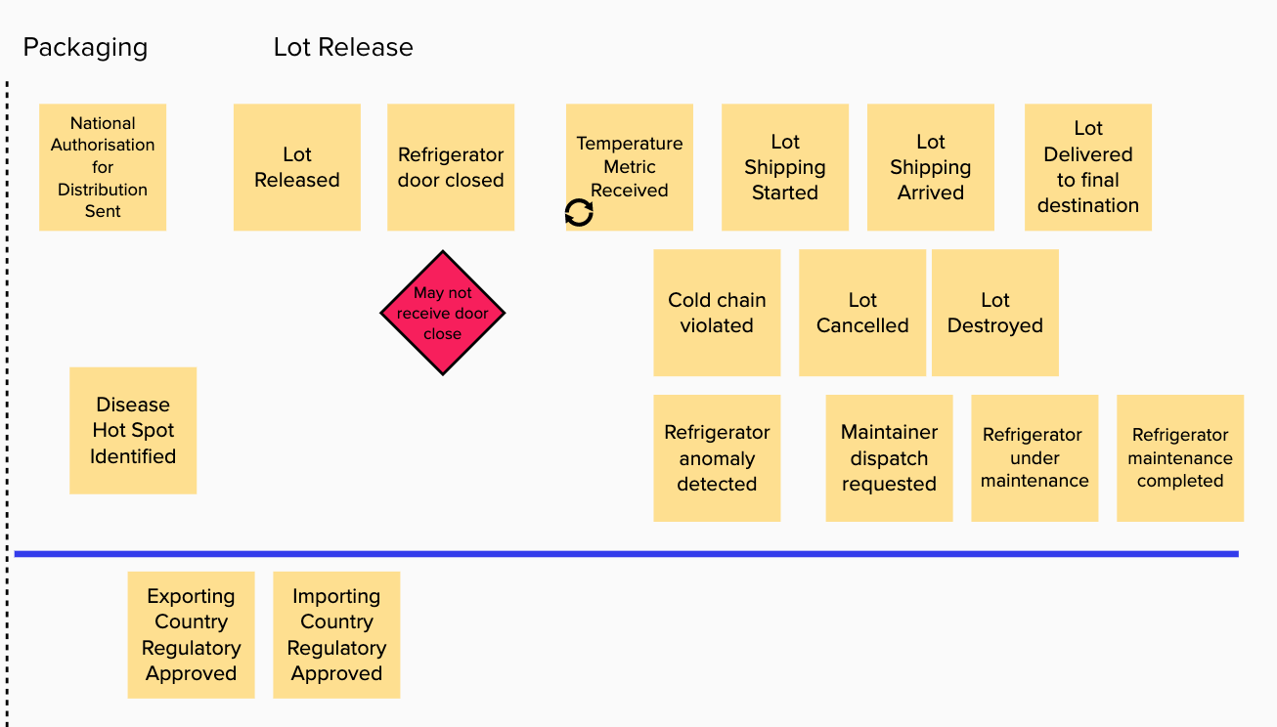
Understanding the process
Event Storming Goals
Understand the end to end business process from an event point of view
Cloud Native app
Domain Driven Design

Slide 8
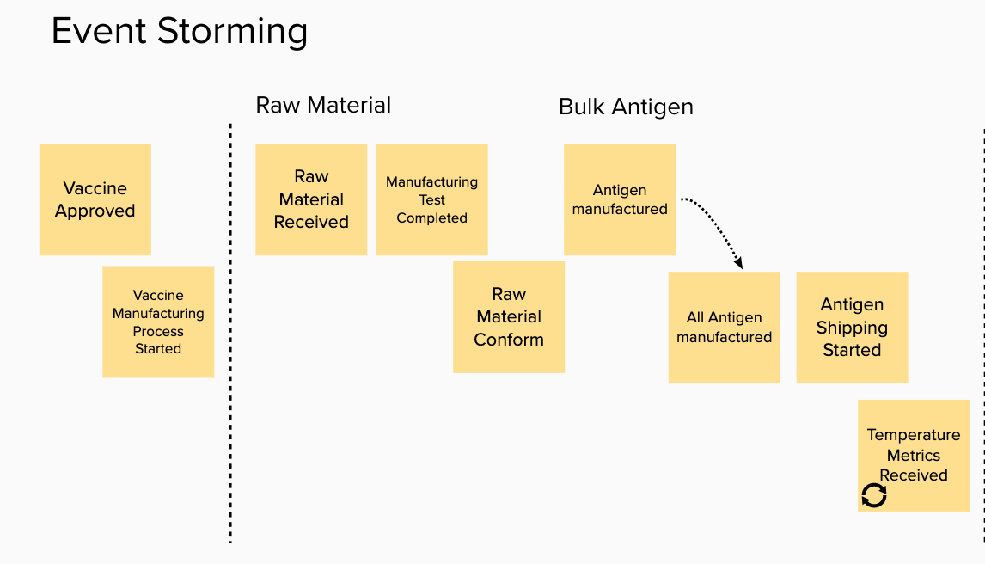
Vaccine Process – Event Storming

Slide 9
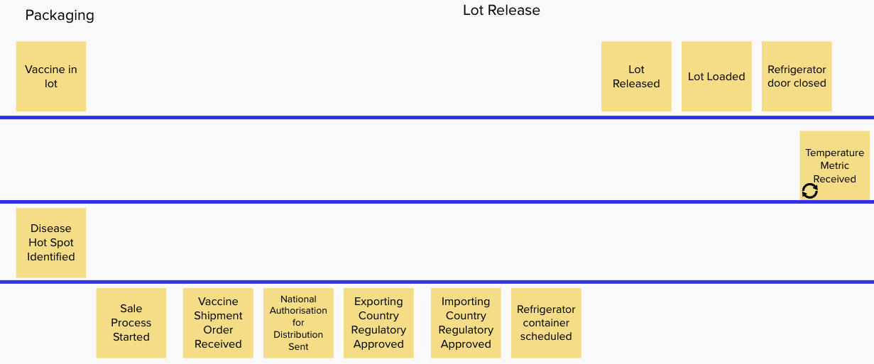
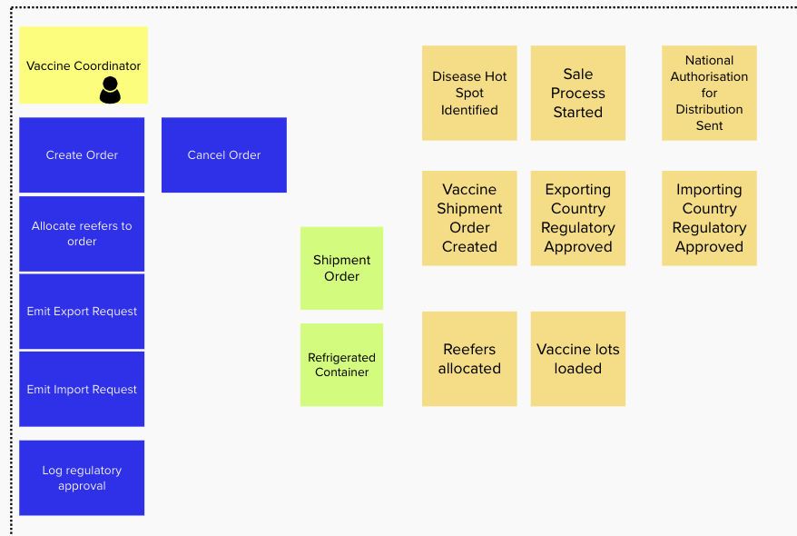

Slide 10
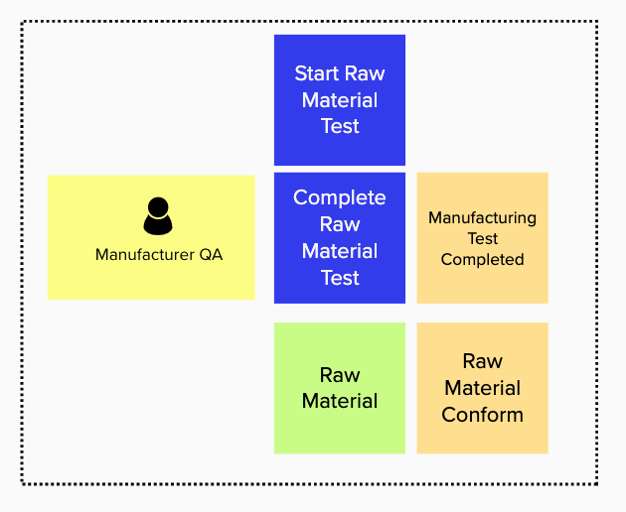
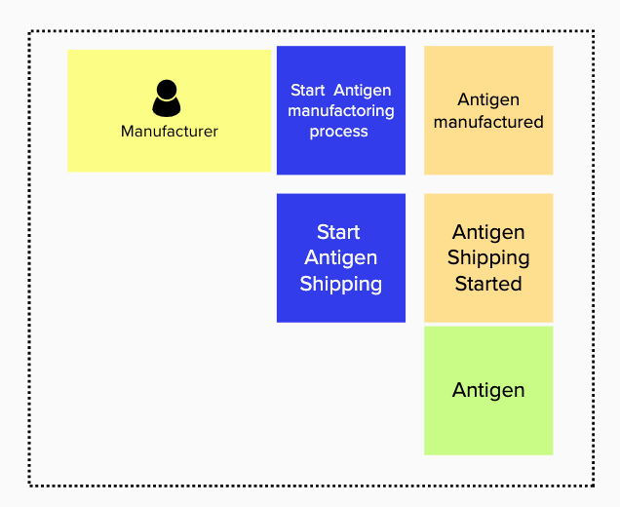
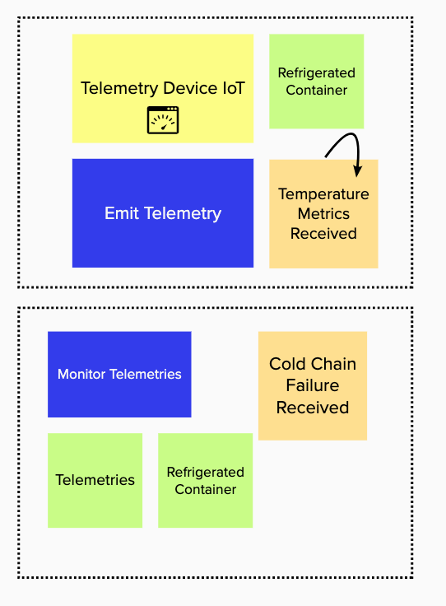
Bounded Contexts : Applying DDD
Entities, Commands, Actors -> Bounded contexts

Slide 11
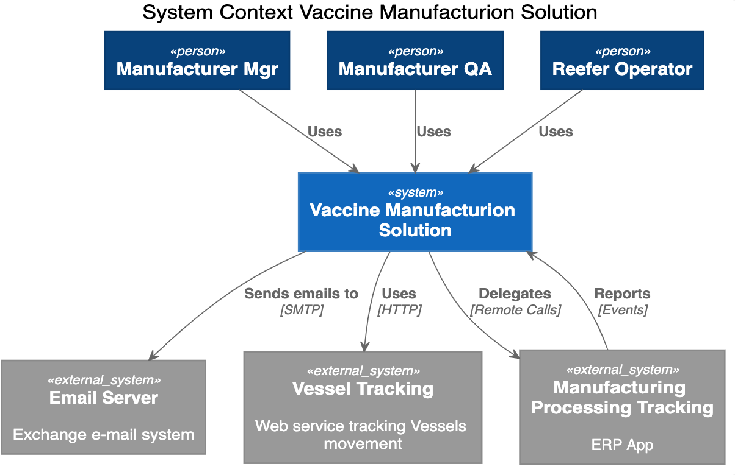
System Context

Slide 12
Deployment View

Slide 13
Cloud Paks – Pre-integrated for cloud use cases
Today, IBM offers clients the first five Cloud Paks…
IBM Cloud Pak for Applications
Build, extend deploy, and run applications
IBM Cloud Pak for
Data
Collect, organize, and analyze data
IBM Cloud Pak for Integration
Integrate applications, data, cloud services,
and APIs
IBM Cloud Pak for
Automation
Transform business processes, decisions, and content
IBM Cloud Pak for
Multicloud Management
Multicloud visibility, governance, and automation
IBM containerized software
IBM containerized software
IBM containerized software
IBM containerized software
IBM containerized software
Operational services
Operational services
Operational services
Operational services
Operational services
Container platform
Container platform
Container platform
Container platform
Container platform
Pre-integrated Systems
IBM Confidential
IBM Cloud / © 2019 IBM Corporation
13

Slide 14


Cloud Pak for Integration
A faster, more secure way to move your core business applications to any cloud through enterprise-ready containerized software solutions
IBM containerized software
Complete yet simple
IBM certified
Run anywhere
API Lifecycle
App & Data Integration
Enterprise Messaging
Events
High Speed Transfer
Integration Security
Container platform and operational services Logging, monitoring, security, identity access management
14

Slide 15
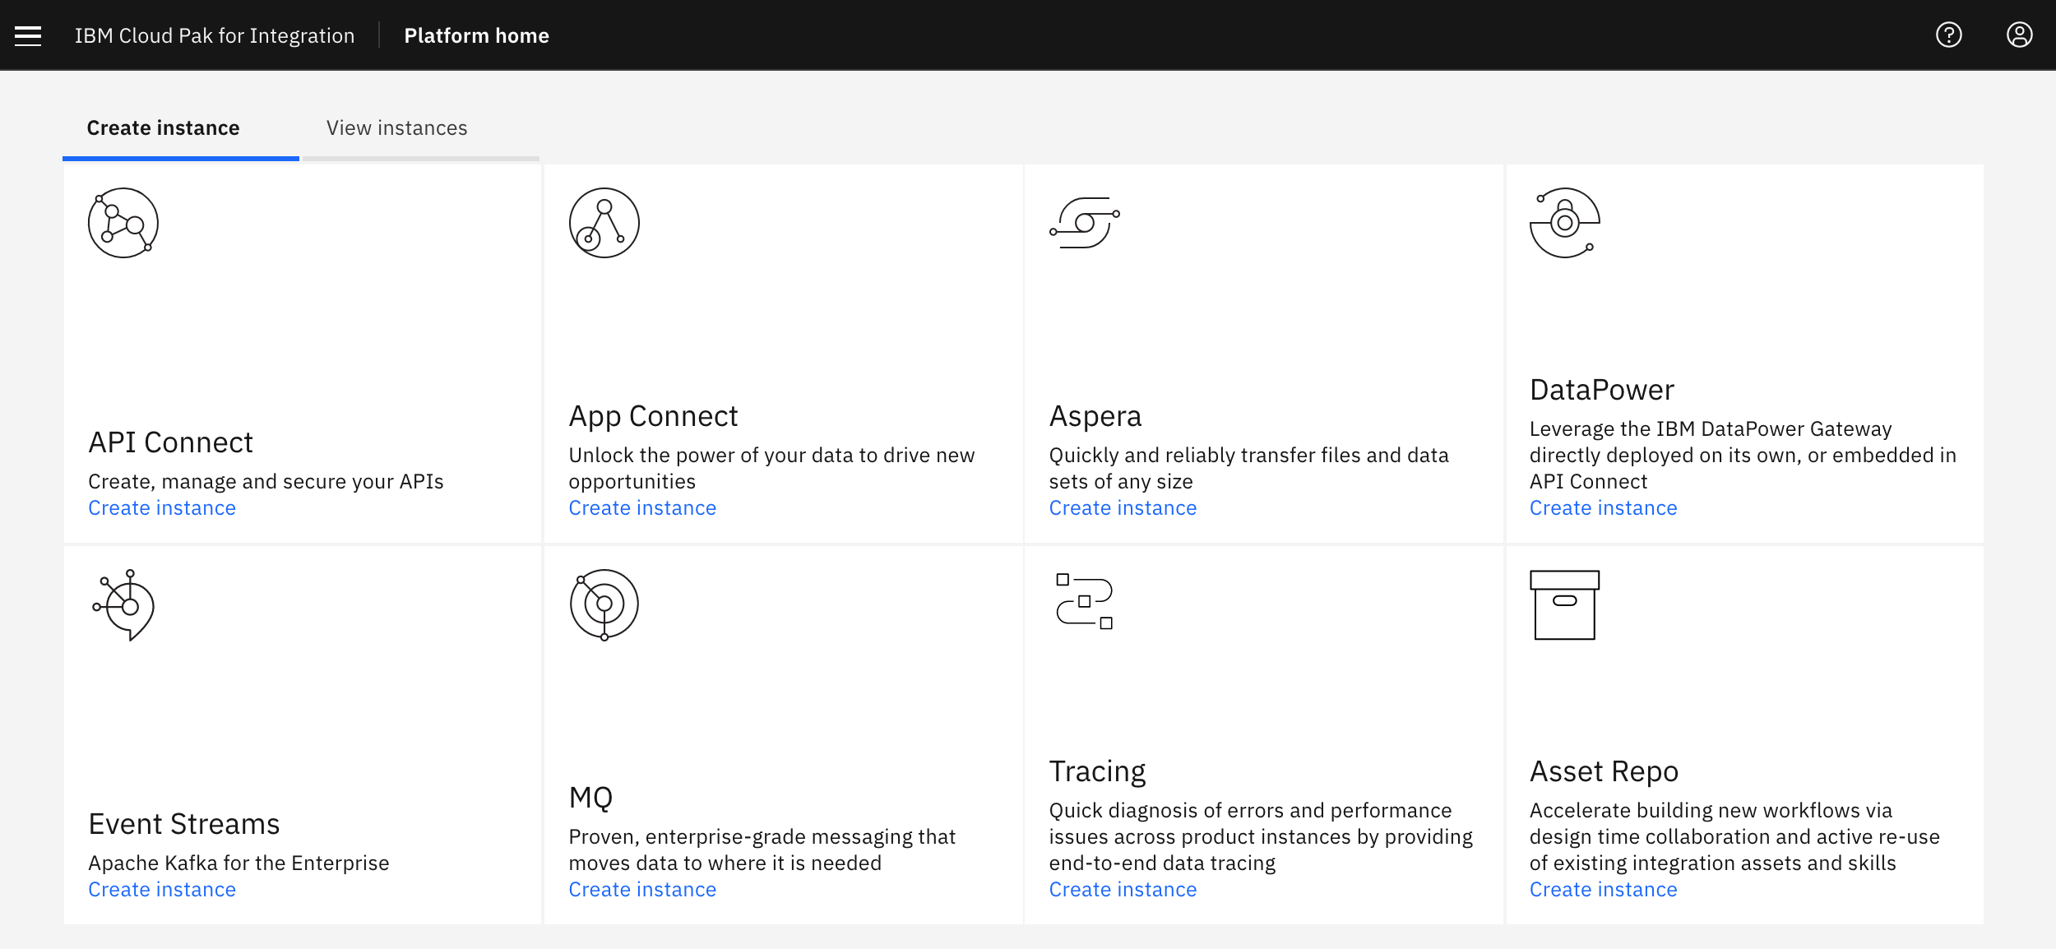
Apache Kafka Orchestrated with Kubernetes
Choose IBM Event Streams from the catalog to deploy a Kafka cluster with ease
It comes
Highly available
Secure
Ready for production

Slide 16

Integration
OpenShift
Vaccine At Scale Solution
Vaccine Order Mgr
Order Shipment Optimization
Reefer Mgr
Reefer Container
Simulator
Reefer Monitoring Agent
Kafka
0
1
2
3
0
1
2
3
0
1
2
3
0
1
2
3
0
1
2
3
orders
lot inventory
shipment plan
reefers
telemetries
Cloud Pak Integration
On-premise or Cloud Providers (IBM, AWS, GCP, Azure...)

Slide 17
Reefer IoT Simulator
Single Page App
OpenShift
Refrigerator Container
Simulator
telemetries
Kafka Based Messaging
0
1
2
3
alerts via SSE
Cloud Pak Integration
Freezer Manager Query

Slide 18

Cold Chain Monitoring
OpenShift
Reefer Monitoring Agent
Refrigerator Container
Simulator
0
1
2
3
4
0
1
2
3
Freezer Manager
telemetries
reeferAlerts
Cloud Pak Integration

Slide 19

Freezer manager CQRS with MQ and MQ connector
OpenShift
Freezer Manager Command
Kafka Connect
MQ Brokers
0
1
2
freezers
MQ Source Connector
3
Postgresql
reefer
inventory
MQ Sink Connector
Freezer Manager Query
Cloud Pak Integration

Slide 20
Anomaly detection
OpenShift
Reefer Monitoring Agent
Anomaly Detection Scoring
Refrigerator Container
Simulator
Watson ML
Event Streams
Freezer Manager
telemetries
reefers
0
1
2
3
4
0
1
2
0
1
2
3
Maintenance Process
reeferAlerts
Business Automation

Slide 21
vaccine-order-mgr
Vaccine Order Reefer Optimization
Vaccine Order Mgr
Order Entity
Order Events
Kafka Connect
Kafka
Change Data Capture
0
1
2
3
4
0
1
2
3
Postgresql
orders
shipment plan
Cloud Pak Integration
OpenShift

Slide 22
vaccine-order-mgr
vaccine-solution
Vaccine Order Mgr
Vaccine Order Optimizer
PV
Postgresql
Kafka Connect Cluster
Debezium Postgres Connector
Brokers
Zookeepers
Cloud Pak Integration
OpenShift

Slide 23
VORO components
OpenShift
vaccine-order-optimizer service
Vaccine Order Reefer Optimization
APP
Transportation Event Consumer
0
1
2
3
Order Resource
Refrigerator Event Consumer
0
1
2
3
Shipment Plan Optimizer
Lot Inventory Event Consumer
0
1
2
3
Data Repository
0
1
2
3
Shipment Plan Event Producer
Decision Optimization Service

Slide 24
Vaccine Order Refrigerator Optimizer
Vaccine Order Reefer Optimization
Manufacturer Simulator
Transportation Simulator
Refrigerator Manager
Vaccine Order Mgr
Event Streams
Postgresql
0
1
2
3
4
0
1
2
3
0
1
2
3
0
1
2
3
0
1
2
3
Debezium
cdc
shipment plan
vaccine lots
transportation
reefers
orders
Cloud Pak Integration
OpenShift

Slide 25
Assess Business Entity Life Cycle life
Place Order
Order Settlement States
Order in transit States
Order Delivery and Complete
Modify Order
Voyages:
Full container
Ready
Created
(pending)
Full Container
Ready
Orders: Container delivered
Container delivered
Order: No
availability
Order: booked
Order: Container on ship
Orders: Completed
Order Booked waiting Reefer
Rejected
no Availability
Container
On Plane
Order completed
Order:
container
Allocated
Orders: Container off ship
Container
Allocated
Container
Off Plane
( Modifications
No longer accepted )
Order spoiled temp out of range
Containers: Temp OutofRange
Notes:
Focus on maturing the entity along its lifecycle
Identify role specific information required to mature the entity

Slide 26
Multi clouds deployment
Reefer
Simulator
Vaccine Order Mgr
Reefer Mgr
Maintenance Process
Reefer Planning Optimization
Anomaly Detection
Event
Streams
API Management
BAW
Watson ML
Cloud Pak For Integration
Cloud Pak for Automation
Cloud Pak For Data
MCM
OpenShift
OpenShift
OpenShift
On-premise or Cloud Providers (IBM, AWS, GCP, Azure...)

Slide 27
Cloud Pak for Application

Slide 28
Cloud Pak for Data

